Slide 1
AAMRAPALI V
Final Project

Slide 2
Moving Object Detection

Slide 3
Agenda: Moving Object Detection with YOLO (Essential)
I. Introduction (5 minutes)
What is moving object detection?
Introduction to YOLO (briefly)
II. Setting Up (10 minutes)
Install Python, OpenCV, and download a pre-trained YOLO model.
III. Implementation (30 minutes)
Load the YOLO model.
Perform object detection on video frames.
Visualize detections.
IV. Evaluation (10 minutes)
Briefly discuss model performance metrics.
V. Conclusion (5 minutes)
Summary and resources.

Slide 4
Problem Statement
Develop a system that can accurately detect and localize moving objects in real-time video streams or image sequences using the YOLO object detection framework

Slide 5
Project Overview
This project aims to develop a real-time system for detecting and localizing moving objects in video streams or image sequences. We will leverage the capabilities of the YOLO (You Only Look Once) object detection framework to achieve this objective.
Project Goals:
Implement a YOLO-based object detection pipeline to identify and classify pre-defined objects (e.g., people, vehicles) within video frames.
Utilize bounding boxes to accurately localize the detected objects in each frame.
Achieve real-time processing speeds for video streams, enabling near-instantaneous detection.

Slide 6
Who are the end users?
Security and Surveillance Professionals
Traffic Management Specialists
Industrial Automation Engineers (working in manufacturing or logistics)
Agricultural and Environmental Monitoring Specialists

Slide 7
Solution and its value preposition
Solution
This project delivers a real-time moving object detection system built using the YOLO framework. It analyzes video streams and instantly identifies and locates moving objects within them.
Value Proposition
The YOLO system provides real-time insights into various environments, benefiting a wide range of users:
Improved Security: Enables faster response times to security incidents through real-time detection of people or vehicles in surveillance footage.
Enhanced Traffic Management: Provides real-time traffic data for optimizing traffic flow and reducing congestion.
Increased Industrial Efficiency and Safety: Tracks objects in production lines, allowing for real-time anomaly detection and accident prevention.
Data-Driven Agricultural and Environmental Monitoring: Detects crops, pests, or wildlife, providing valuable data for precision agriculture and conservation efforts.

Slide 8
The wow in our solution
The "wow" factor of this YOLO solution is its ability to see the unseen in real-time videos. Here's how it breaks down:
Magic Eye: Imagine a system that acts like a super-powered eye, constantly scanning video feeds and instantly spotting anything that moves – people, vehicles, even animals! That's the magic of YOLO.
Real-Time Reactions: Forget waiting for security footage review. YOLO detects objects as they happen, allowing for immediate response to security threats or traffic issues. It's like having a live guardian on duty.
From Blurry to Brilliant: YOLO cuts through grainy footage, identifying objects even in less-than-ideal lighting conditions. It brings clarity to what would otherwise be a guessing game.

Slide 9
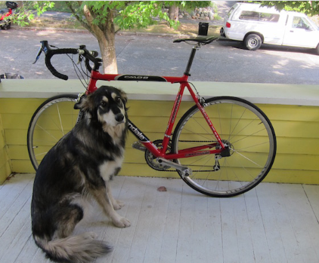
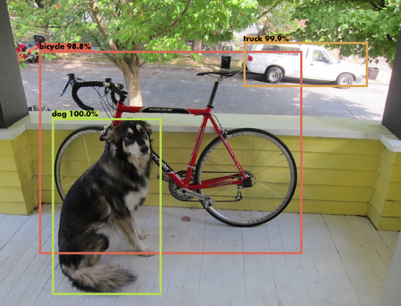
Modelling
Data Collection and Annotation: Gather and label a dataset containing moving objects.
Model Selection: Choose a YOLO model (e.g., YOLOv3, YOLOv4).
Training: Train the model on annotated data, adjusting hyperparameters as needed.
Evaluation: Assess model performance using metrics like precision and recall.
Fine-Tuning (Optional): Adjust the model or collect more data for better performance.
Deployment: Integrate the trained model into your system for real-time moving object detection.

Slide 10
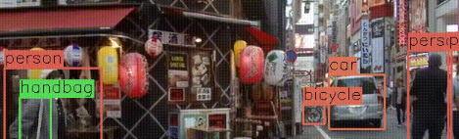
Result
Moving Object Detection Results:
Object 1:
Type: Car
Confidence: High
Object 2:
Type: Person
Confidence: Medium
Object 3:
Type: Bicycle
Confidence: High
This information gives an overview of the detected objects and their reliability, allowing users to make informed decisions or take appropriate actions based on the results.
DEMO LINK:
https://www.kaggle.com/code/lakshithadevarajulu/moving-object-detection-nm-aamrapali.

